Slide 1
LB Multiple 4G LTE
OpenClash Proxy Manager
Present By: Moh. Ali

Slide 2
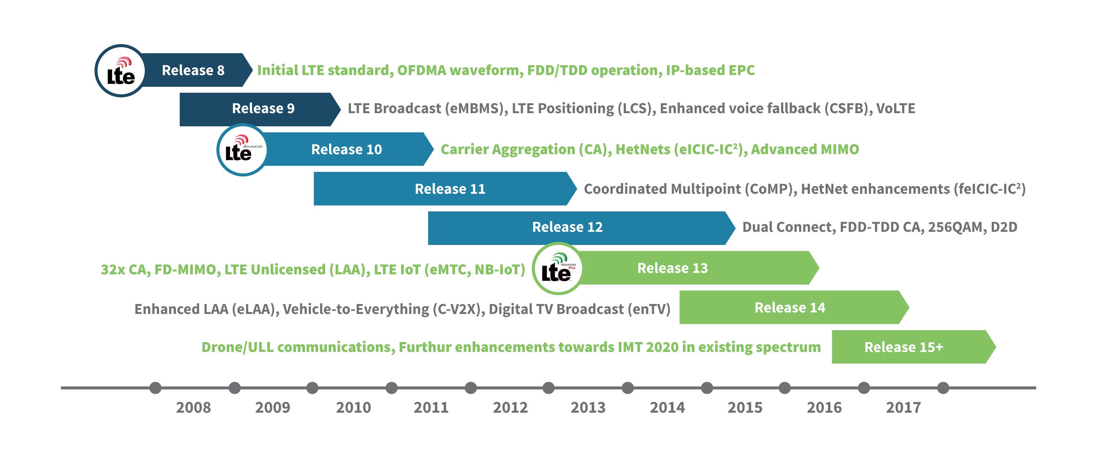

Slide 3
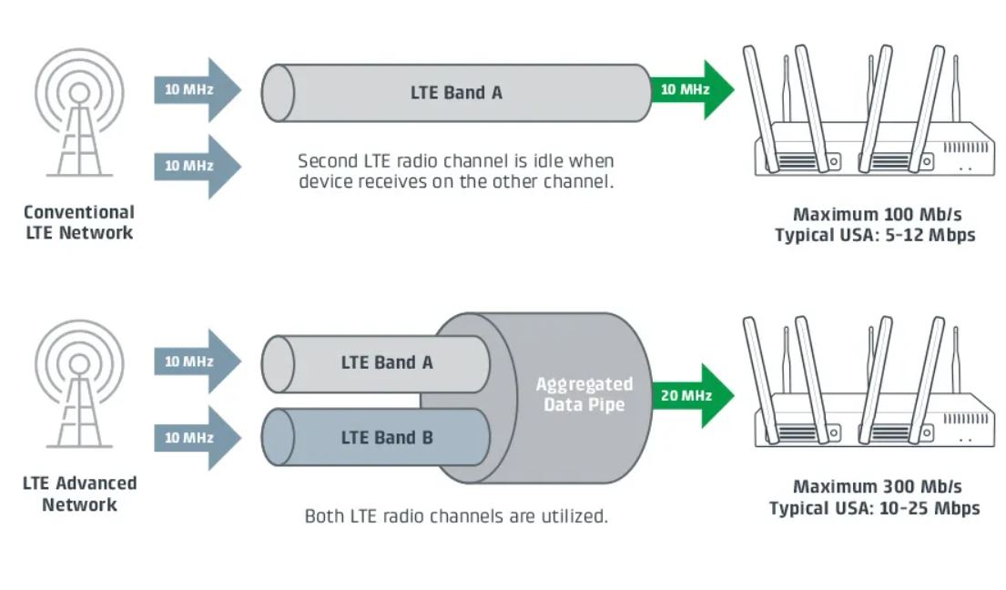

Slide 4
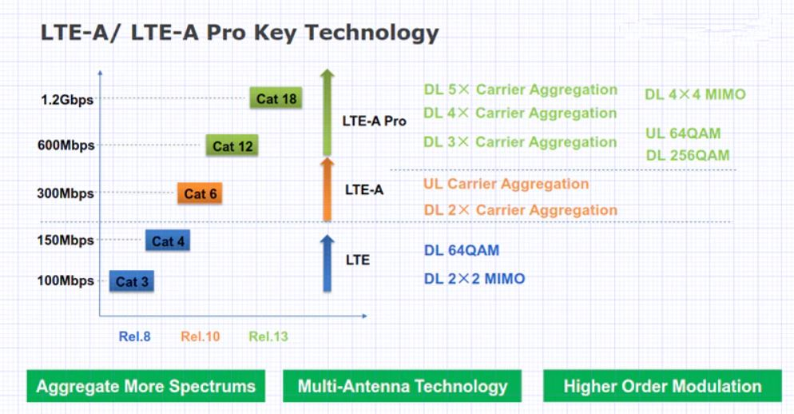

Slide 5

Telkomsel :
BAND 1 → FDD 2100Mhz ( 0x1 )
BAND 3 → FDD 1800Mhz ( 0x4 )
BAND 8 → FDD 900Mhz ( 0x80 )
BAND 40 → TDD 2300Mhz ( 0x8xxxx )
XL :
BAND 1 → FDD 2100Mhz ( 0x1 )
BAND 3 → FDD 1800Mhz ( 0x4 )
BAND 8 → FDD 900Mhz ( 0x80 )

Slide 6
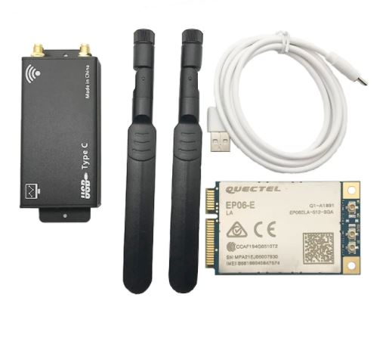
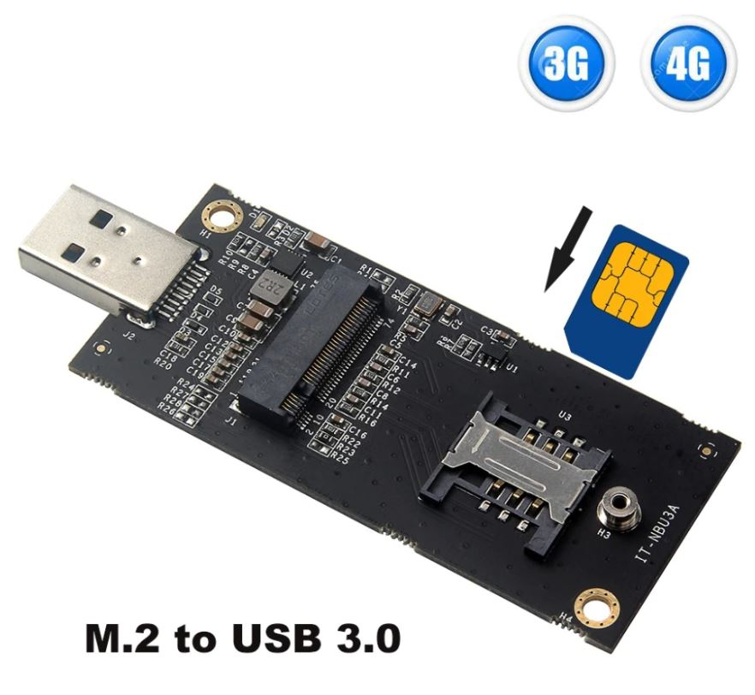
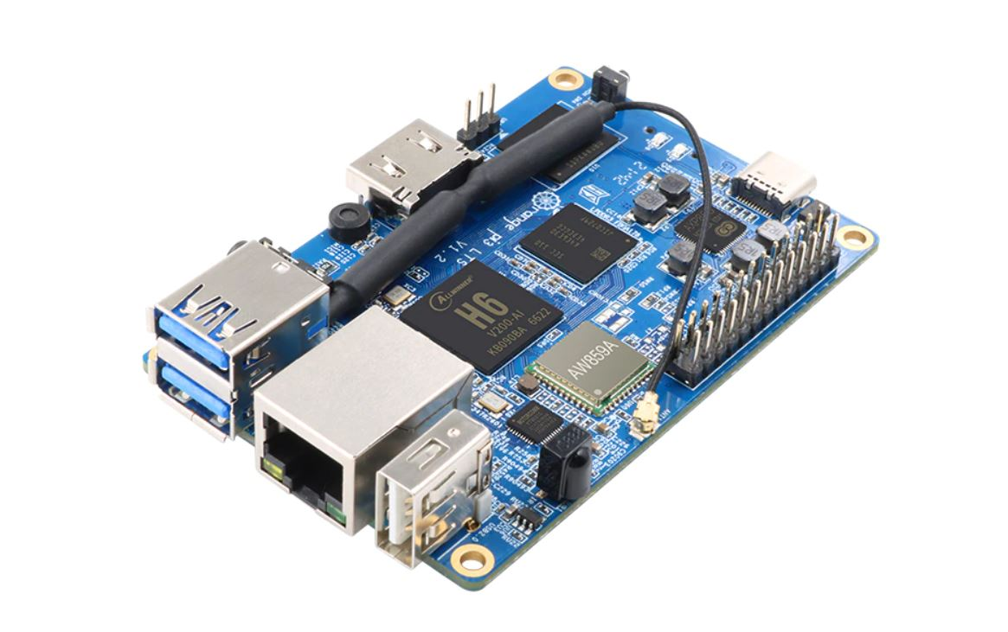

Slide 7
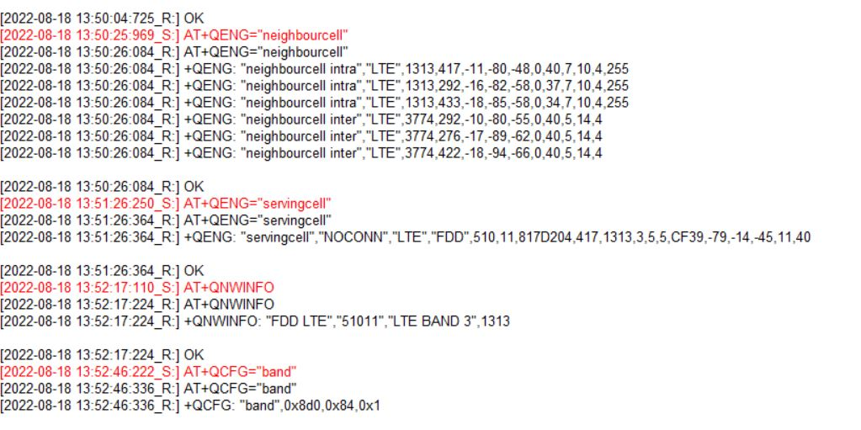
Merubah IMEI :
AT+EGMR=1,7,"xxxxxx"
Module Mode :
AT+QCFG="usbnet",0 → Default QMI Qualcom chip
Lock Band :
AT+QCFG="band",0,84,0,1

Slide 8
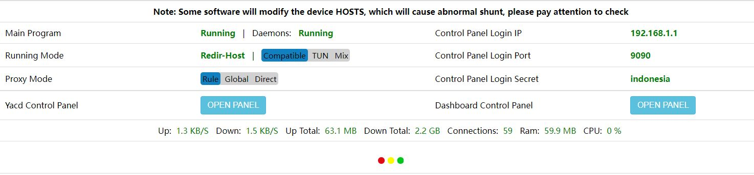
Install from source :
https://github.com/vernesong/OpenClash
Paket lengkap dengan Image OpenWRT OS :
https://radenku.com

Slide 9
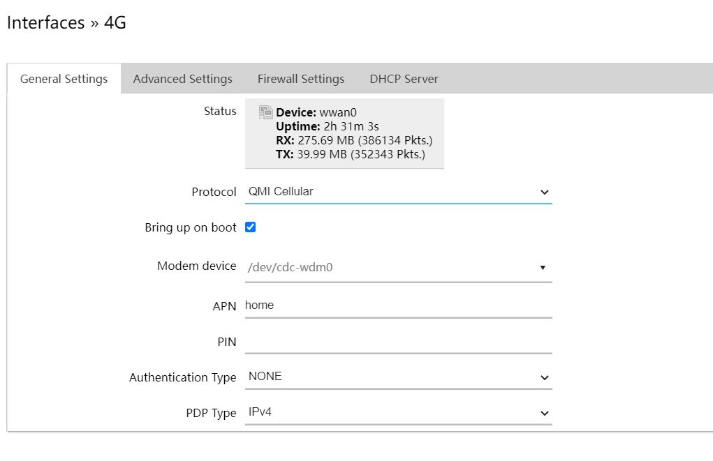
Default Device :
/dev/cdc-wdm0
Default Module Mode :
QMI Protocol QUALCOM Chips

Slide 10
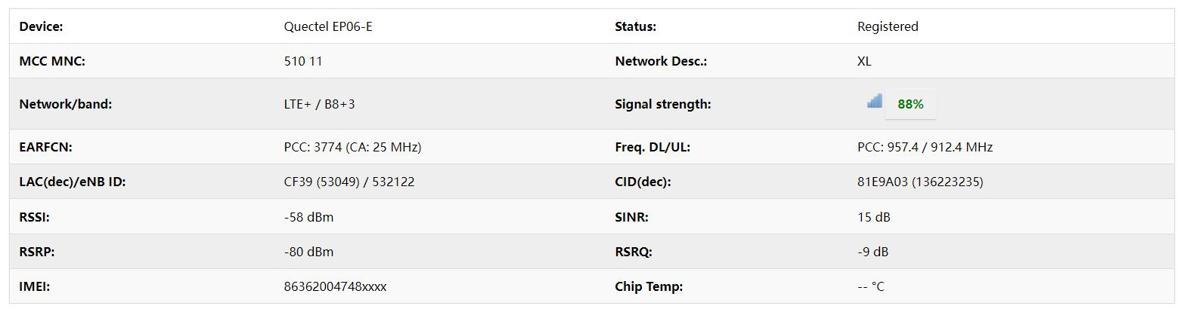
Monitoring Signal Strength:
RSSI → di bawah -70 semakin bagus
RSRP → di bawah -90 semakin bagus
SINR → diatas 5 semakin bagus
RSRQ → di bawah -15 semakin bagus

Slide 11
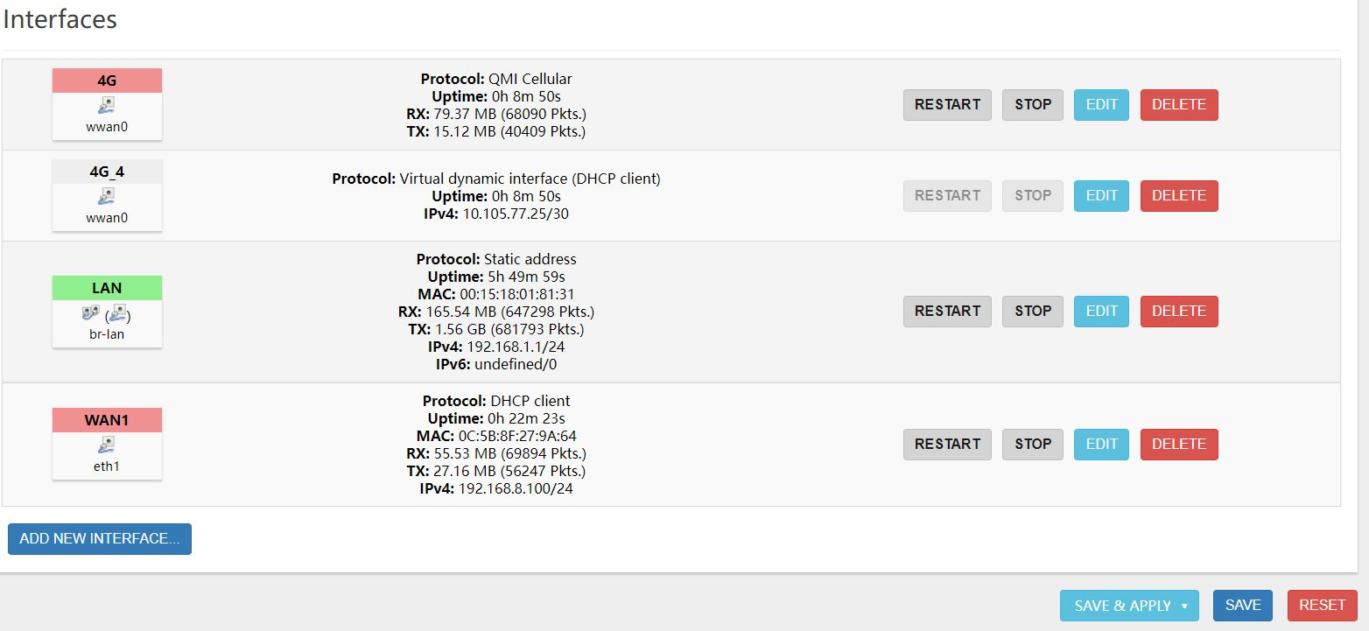
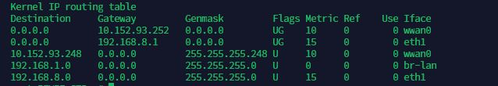

Slide 12
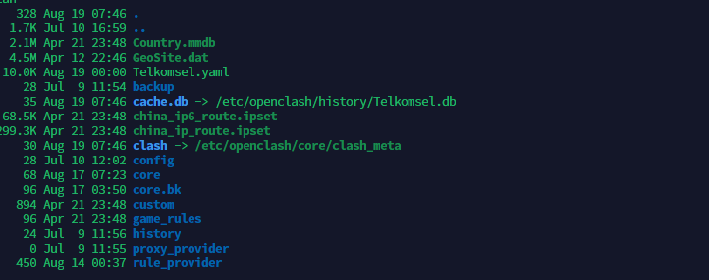
Core file → /etc/openclash/core
Main .yaml File → /etc/openclash
Rule Provider → /etc/openclash/rule_provider

Slide 13
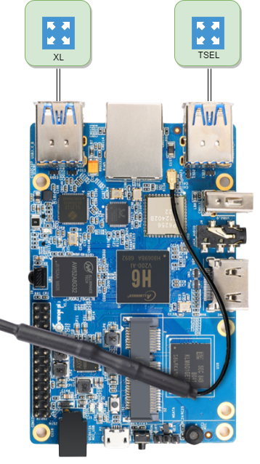
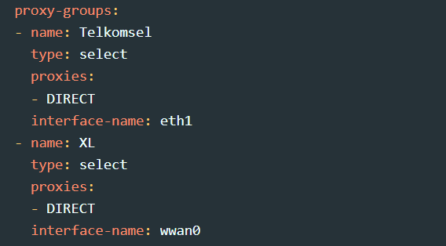

Slide 14
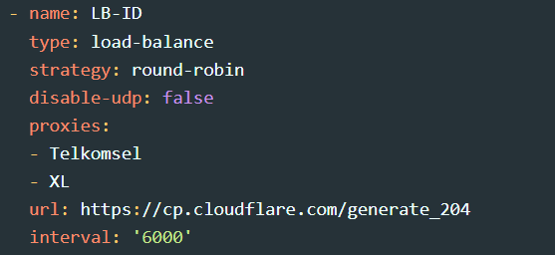

Slide 15
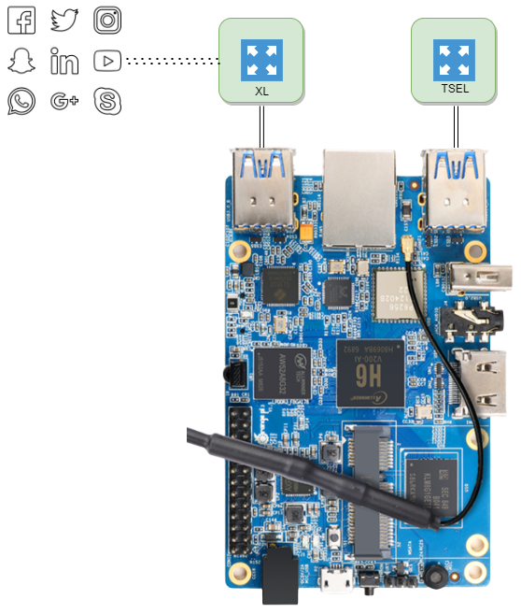
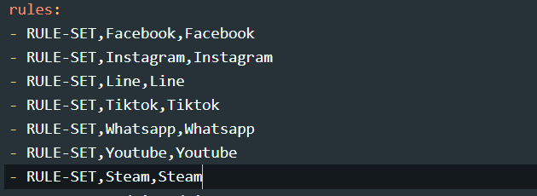
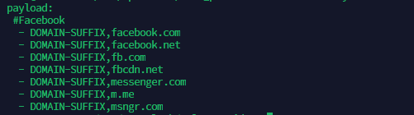

Slide 16
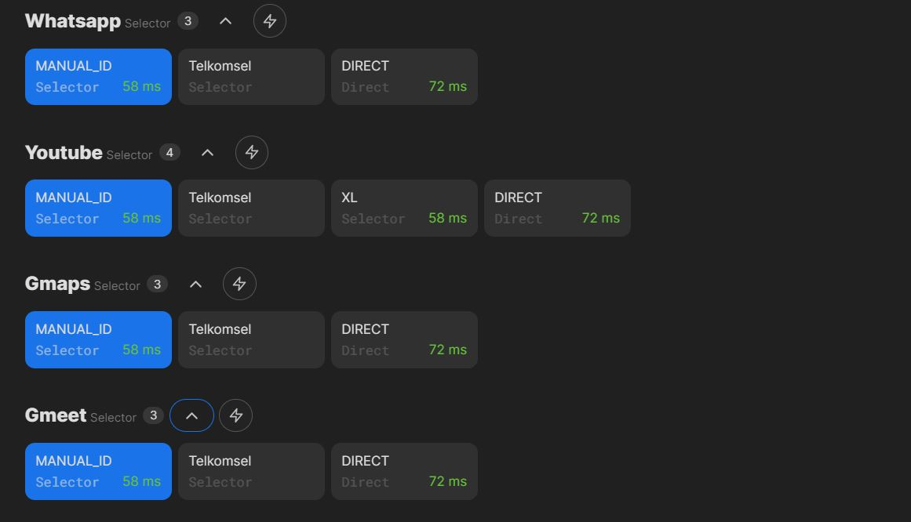

Slide 17
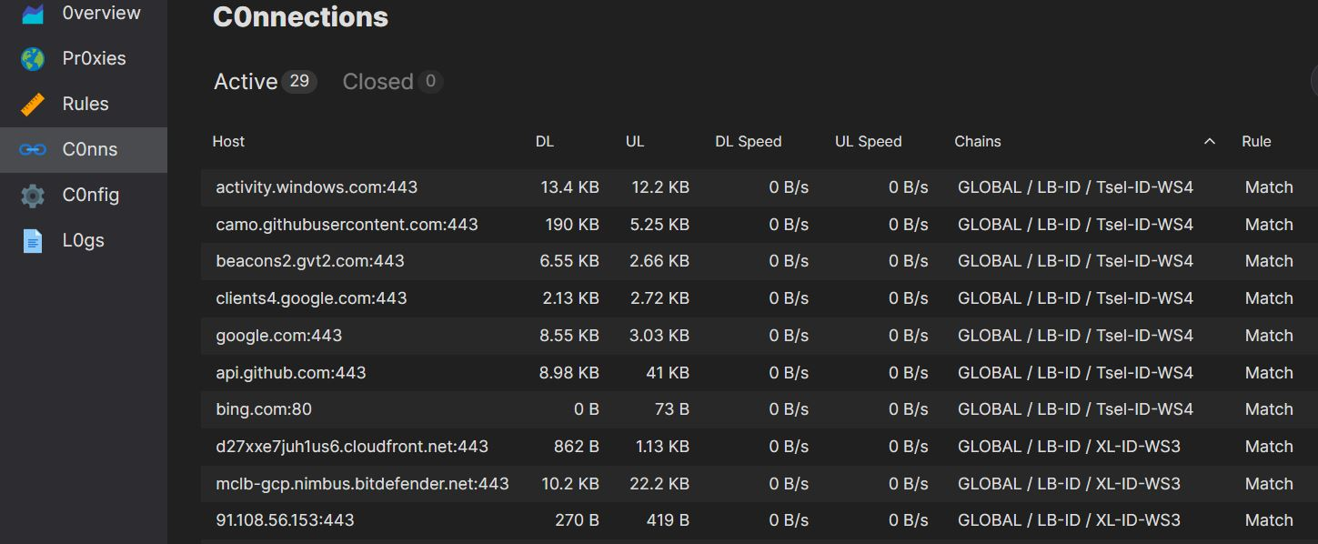

Slide 18
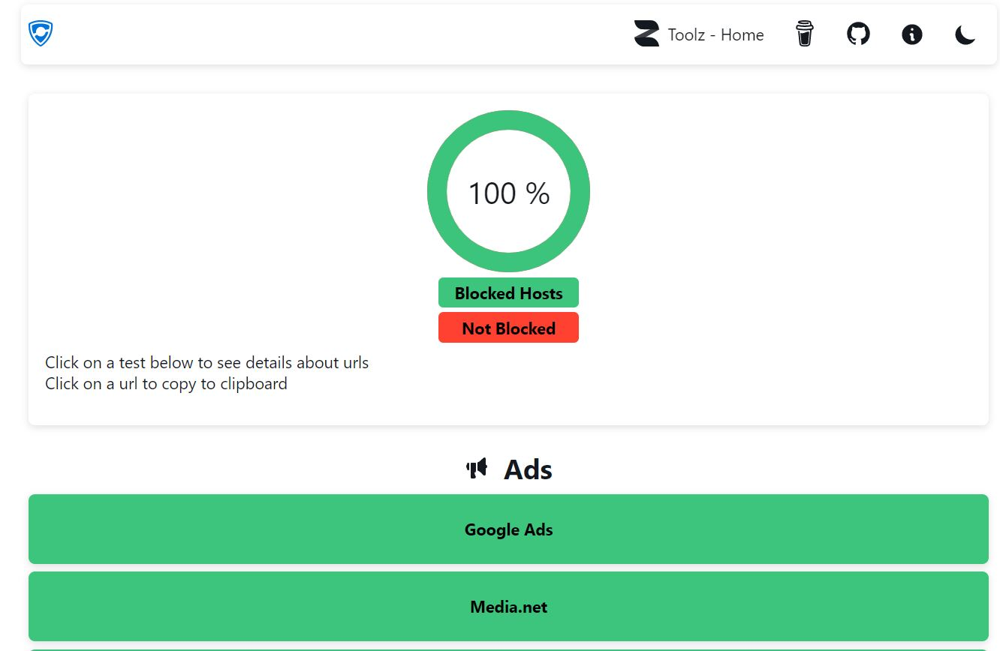
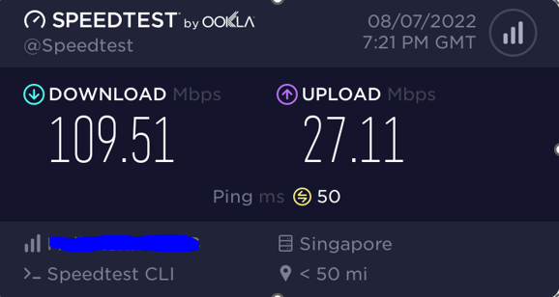
Memiliki performa tinggi dan mampu menjadi Adblock Server via Geosite Rule

Slide 19
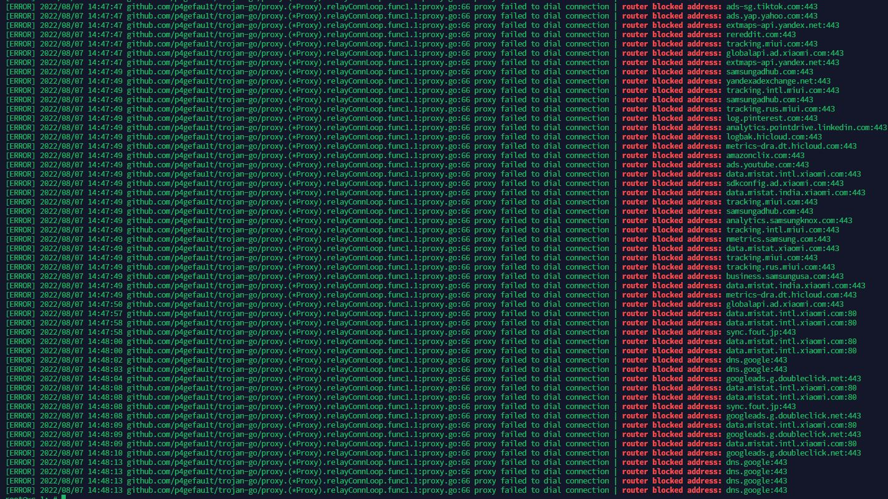

Slide 20

Thank you

https://www.ilc.opensuse.id

